Slide 1
Review of 6D Pose estimation & Human Pose using DeepPose
Presented by: Arnab Debnath, Anowarul Kabir, S M Hasan Mansur

Slide 2
Introduction
6D Object pose estimation
PoseCNN [1]
Segmentation driven pose estimation (SegPose) [2]
PVNet [3]
Human pose estimation
DeepPose [4]

Slide 3
6D object pose estimation
Given an image, the task of pose estimation is to detect objects and estimate their orientations and translations in 3D.
Difficulties
Occlusion
Truncation
Symmetric objects
Different shapes, textures

Slide 4
PoseCNN
Key Contribution
Proposed a novel CNN architecture for 6D pose estimation.
Introduced a new loss function Shape-Match-Loss (SLOSS) for estimating poses of symmetric objects.
Generated a new RGB-D dataset called YCB-Video Dataset.

Slide 5
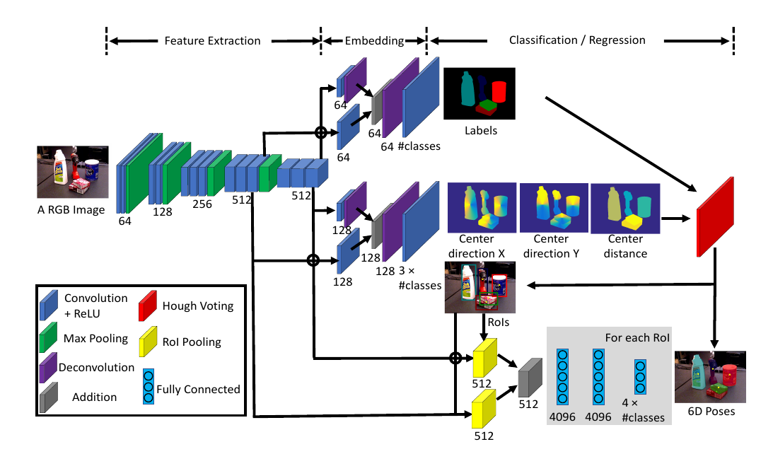
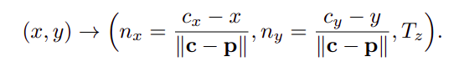
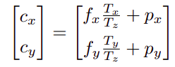
PoseCNN(Network architecture and proposed approach)
VGG-16
Semantic Segmentation
3D translation estimation
Localize center location (cx,cy) and estimate Tz
Hough voting layer used
Solve for Tx, Ty
Generate Bounding boxes

Slide 6
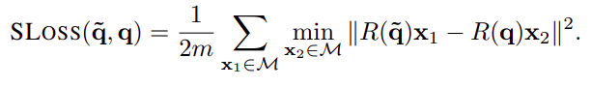
PoseCNN(Network architecture and proposed approach)
3D rotation regression
Use extracted features from the bounding boxes
FC layer
Sloss
Pose Refinement
Use Depth
Slow

Slide 7
SegPose
Key contribution
This paper presents a segmentation-driven approach of 6D pose estimation in a more robust way by combining multiple local predictions instead of a single global one.

Slide 8
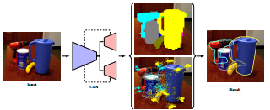
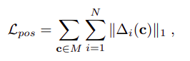
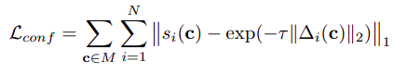
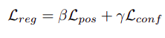
SegPose (Network Architecture and proposed approach)
Darknet-53 architecture of YOLO-v3.
Segmentation
Keypoint Detection
Detect 8 corners of the bounding box
Solve PnP problem

Slide 9
PVNet
Key Contribution
Proposed a novel framework which learns a vector field representation for 2D keypoint localization.
Utilized an uncertainty driven algorithm.
Created a new dataset Truncated Linemod for evaluation.

Slide 10
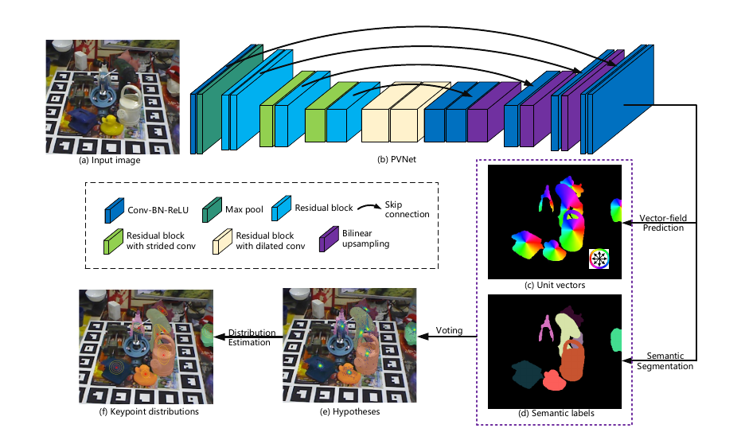
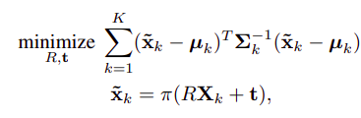
PVNet (Network architecture and proposed approach)
ResNet-18
Semantic segmentation
Keypoint Detection
Keypoints on object surface
Solve uncertainty driven PnP algorithm.

Slide 11
Evaluation results on OccludedLinemod
PoseCNN | SegPose | PVNet
17.2 | 44.9 | 61.06
PoseCNN | SegPose | PVNet
24.9 | 27 | 44.77
2D reprojection metric (mean distance between the projections of 3D model points given the estimated and the ground truth pose.)
ADD-S metric (mean distance between the two transformed point sets.)

Slide 12
Test Results of SegPose

Slide 13
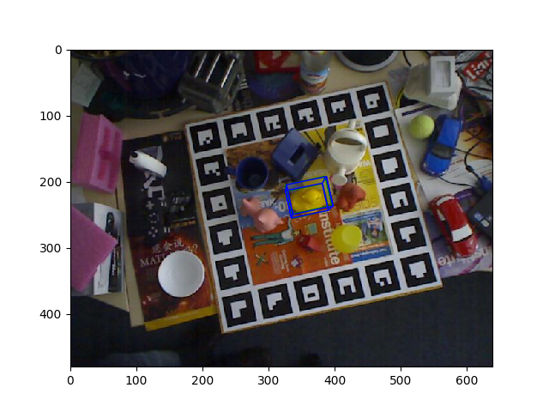
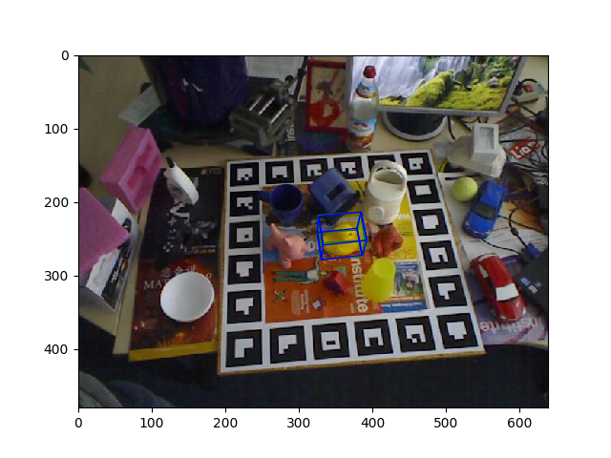
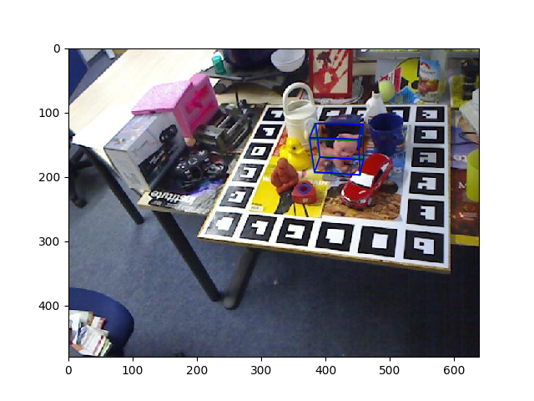
Test Results of PVNet

Slide 14
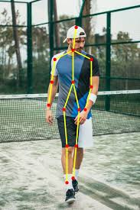
Human Pose Estimation (Deeppose)
Image source
Background: Location of human joints (wrists, elbows etc)
2D pose estimation: (x, y) coordinates of joints in an image
3D pose estimation: (x, y, z) coordinates of joints in an image
Difficult task: Because of different viewpoints, occlusions, clothing, lightening and so on
Importance: Examples of applications are pedestrian detection, player’s action recognition, human surveillance and so on

Slide 15
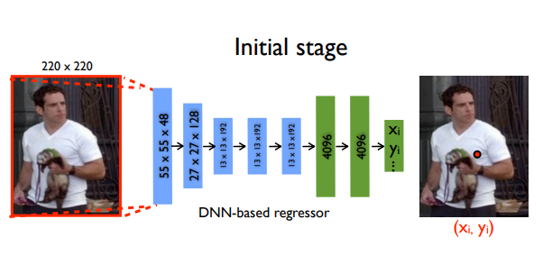
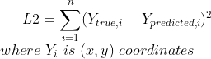
DeepPose: Human Pose Estimation via Deep Neural Networks
Image Source
Problem definition: Regression of human body joints
Neural network architecture: Alexnet (7 layers) + final prediction layer
Final prediction layer: Predicts 2k coordinates, where k=#joints
Loss function: L2 loss function

Slide 16
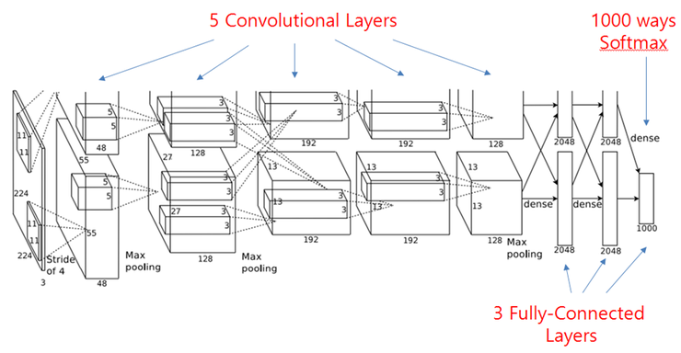
Alexnet
Input image
Convolutional and max pooling layers
Fully connected layers
Output layers
2k output nodes where k is number of joints we want to predict for each image
Alexnet

Slide 17
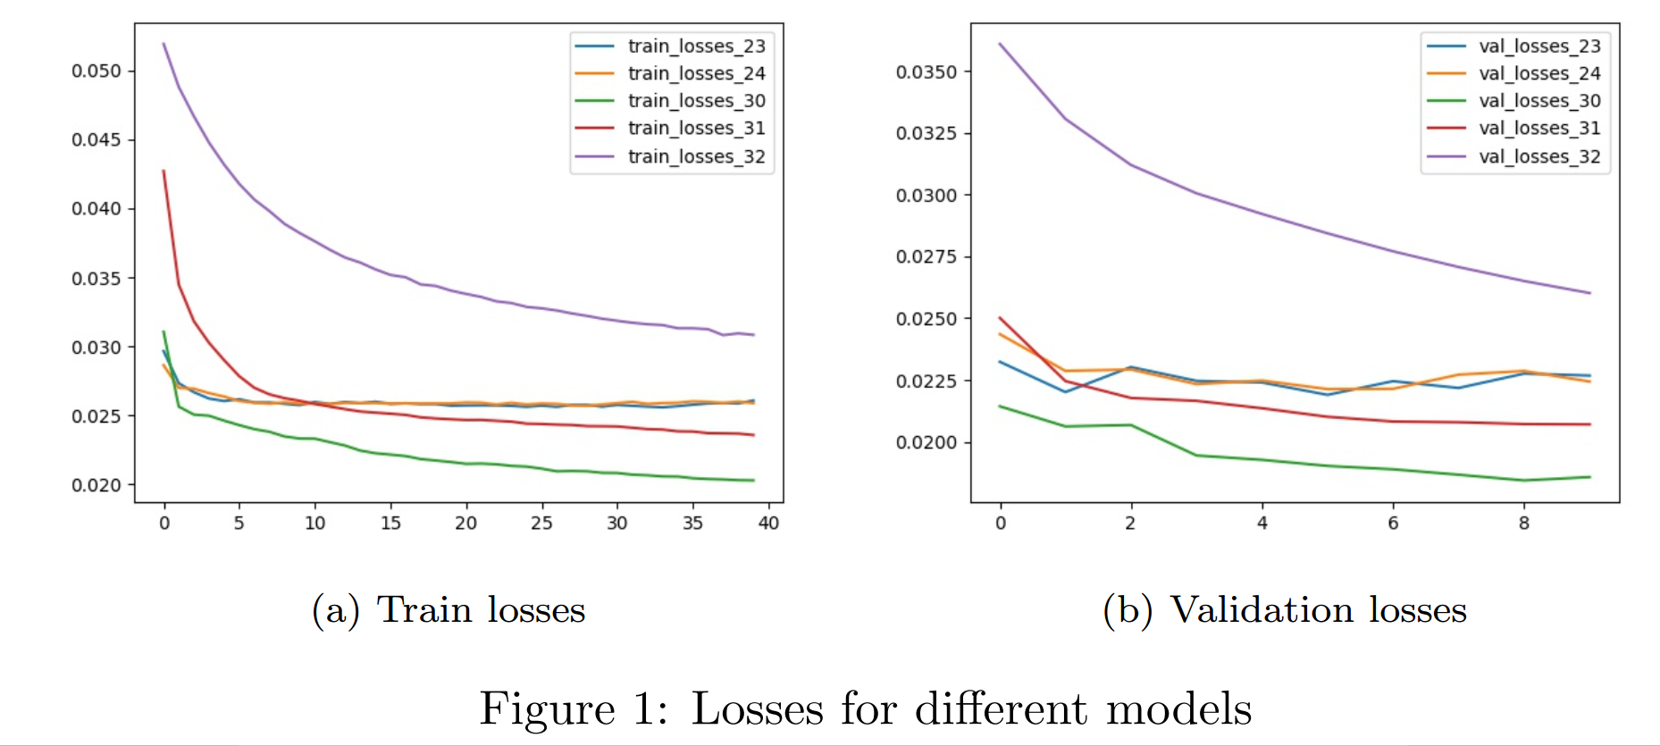
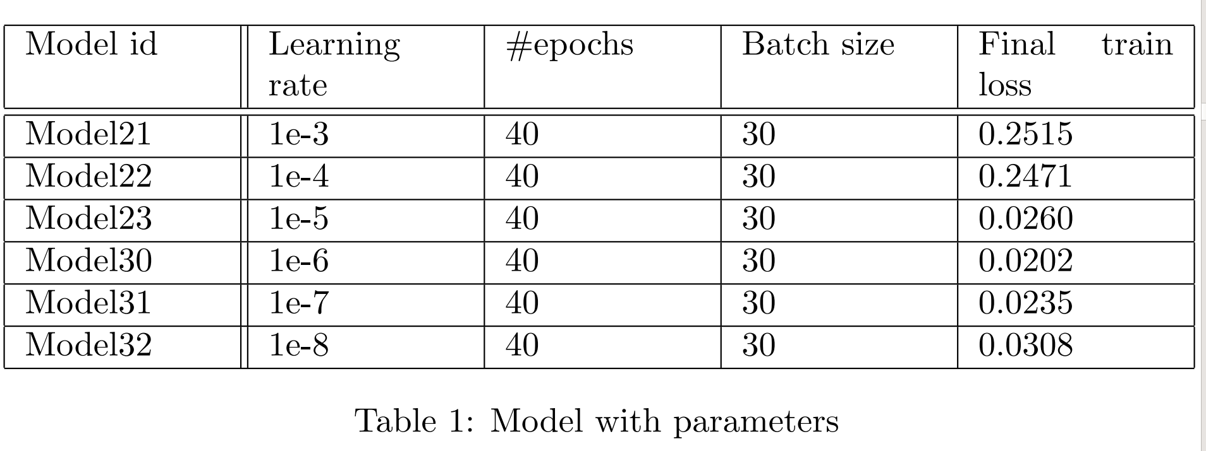
Models and Losses

Slide 18
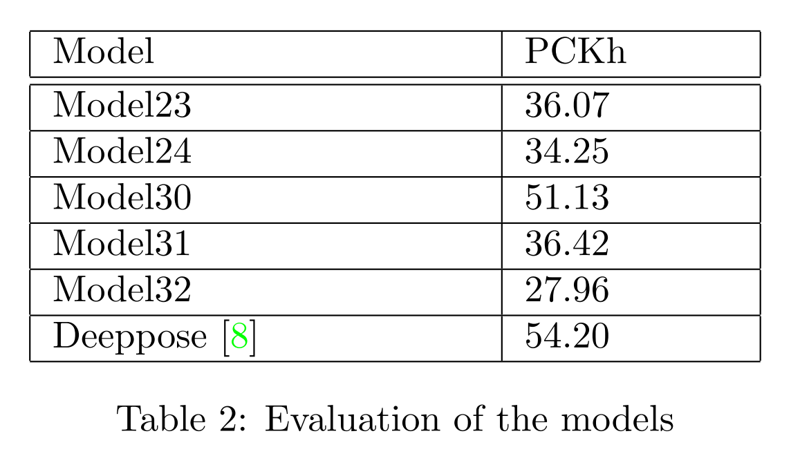
Results and Analysis
PCKh: A detected joint is considered correct if the distance between the predicted and the true joint is within a certain threshold.
Threshold = 0.5

Slide 19
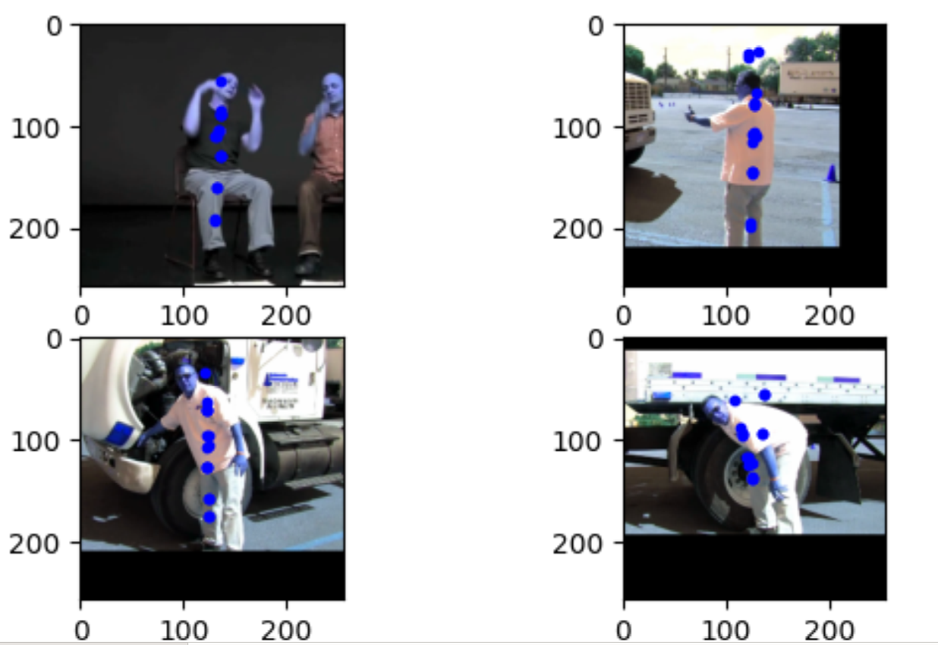
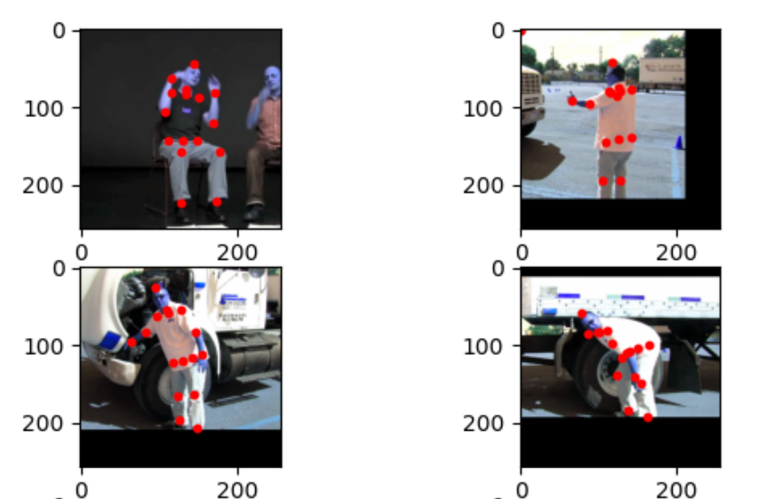
Sample Outputs

Slide 20
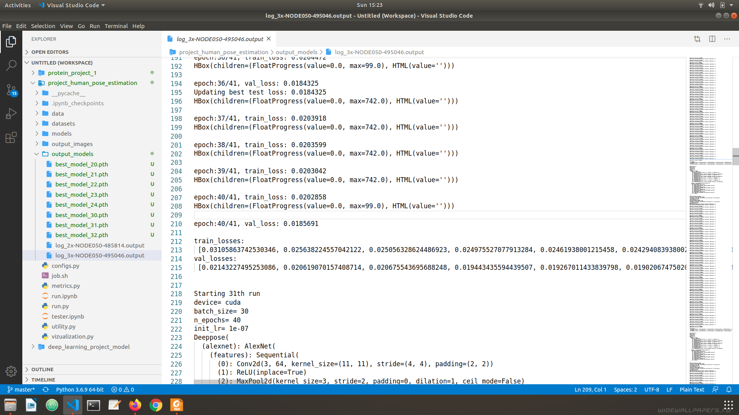
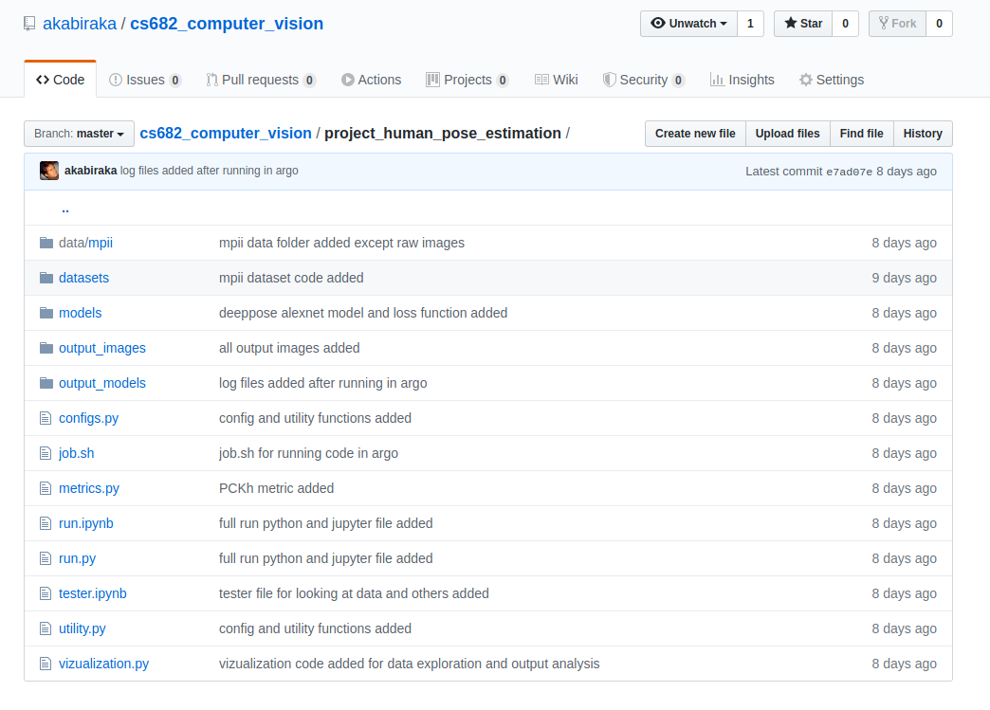
Miscellaneous
Codes are available on Github
Models run on Argo Cluster
Logs are available

Slide 21
References
https://arxiv.org/pdf/1711.00199v3.pdf
http://openaccess.thecvf.com/content_CVPR_2019/papers/Hu_Segmentation-Driven_6D_Object_Pose_Estimation_CVPR_2019_paper.pdf
https://arxiv.org/pdf/1812.11788.pdf
https://arxiv.org/pdf/1312.4659.pdf

Slide 22


